Slide 1
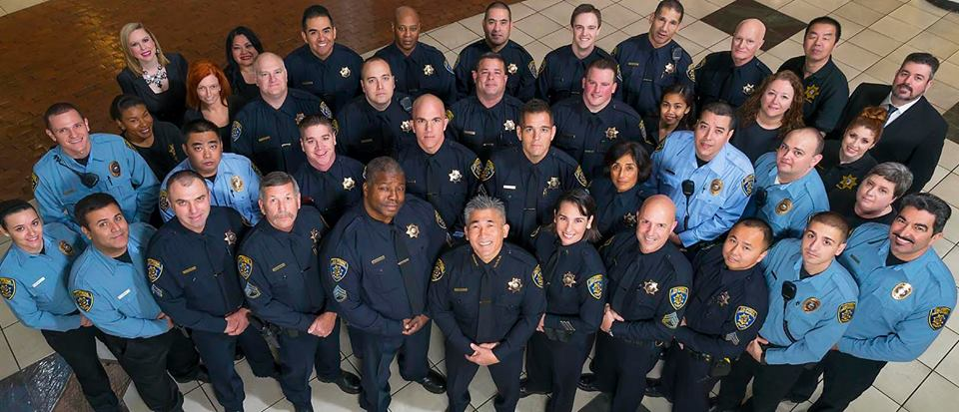
WELCOME TO
COFFEE WITH THE COPS

Slide 2
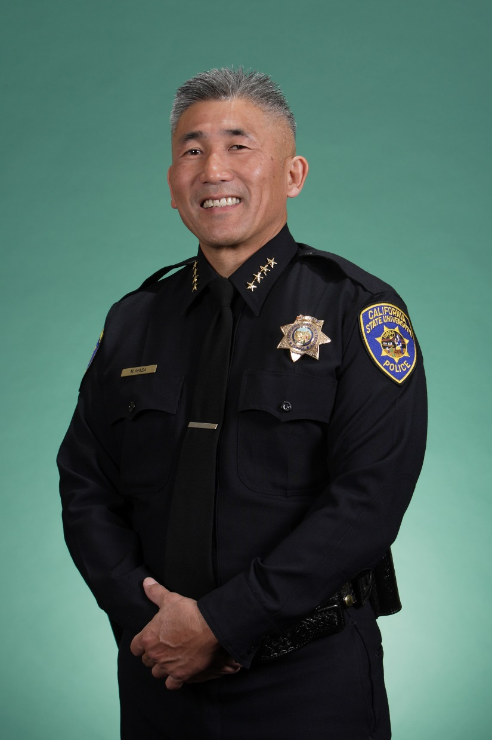
CHIEF
MARK IWASA
32 Years in Law Enforcement
4 ½ Years working at Sacramento State
B.A. Degree in Economics from Sacramento State
M.A. Degree in Public Policy and Administration from Sacramento State
Favorite Hobby: Baseball

Slide 3
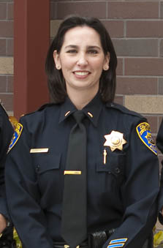
LIEUTENANT
CHRISTINA LOFTHOUSE
16 Years in Law Enforcement
6 Years working at Sacramento State
BA in Political Science from UC Davis and JD from Lincoln Law School
Favorite Hobby: Cycling, Photography and Travel

Slide 4
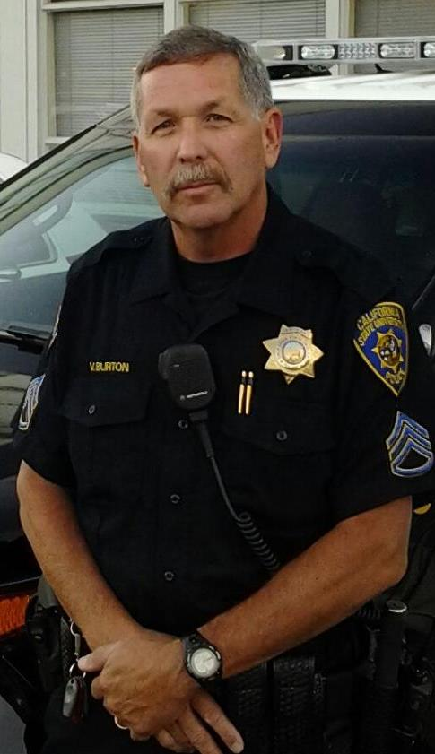
SERGEANT
VINCENT BURTON
36 Years in Law Enforcement

Slide 5
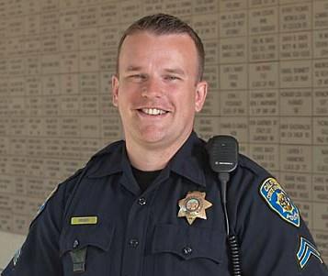
SERGEANT
MATT KRONER
16 Years in Law Enforcement
15 Years working at Sacramento State.
Favorite Hobby: Anything outdoors that involves his family.

Slide 6
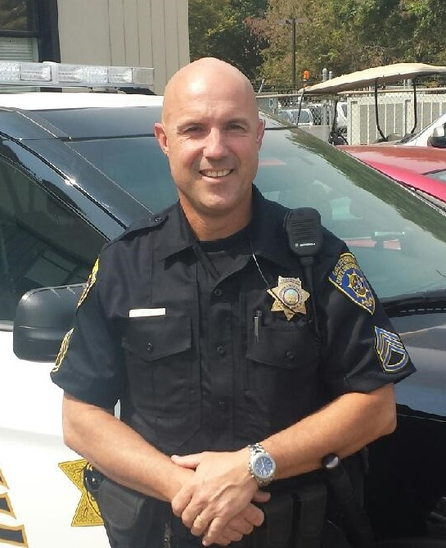
SERGEANT
JEFF REINL
29 Years in Law Enforcement
2nd Year working at Sacramento State.
Favorite Hobby: Golf and anything with family.

Slide 7
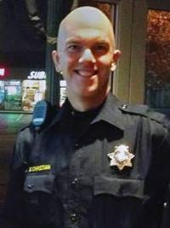
CORPORAL
SCOTT CHRISTIAN
12 Years in Law Enforcement
19 Years working at Sacramento State. Corporal Christian was a computer programmer in the Financial Aid Office for 7 years prior to becoming an Officer
BA in Humanities & Religious Studies
Favorite Hobby: Building and flying RC aircrafts
Master of the Elk Grove Lodge#173, Free & Accepted Masons of California.

Slide 8
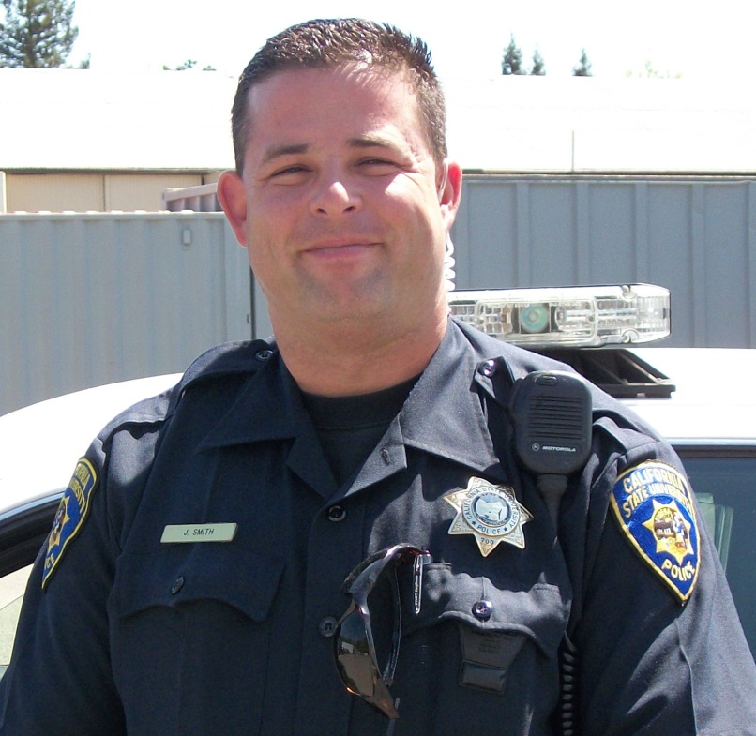
CORPORAL
JESSE SMITH
14 years in Law Enforcement
ASE Parts Tech in his former life
Favorite Hobbies: Tinkering with anything electronic and riding motorcycles.
Father of two

Slide 9
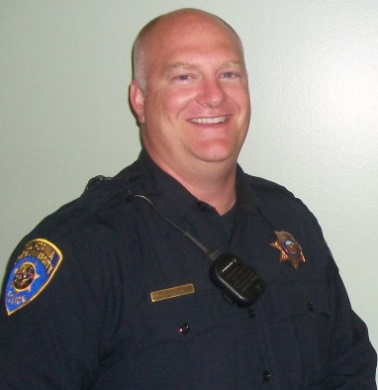
DETECTIVE
JASON JOHNSTON
9 Years in Law Enforcement
8 Years working at Sacramento State
B.A. Degree in Business Administration from Sacramento State
Favorite Hobby: Baseball

Slide 10
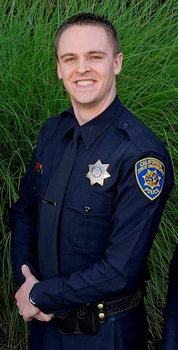
OFFICER
MATT LIGHT
5 ½ Years in Law Enforcement, nearly all of which is working at Sacramento State
B.S. Degree in Criminal Justice from Sacramento State

Slide 11
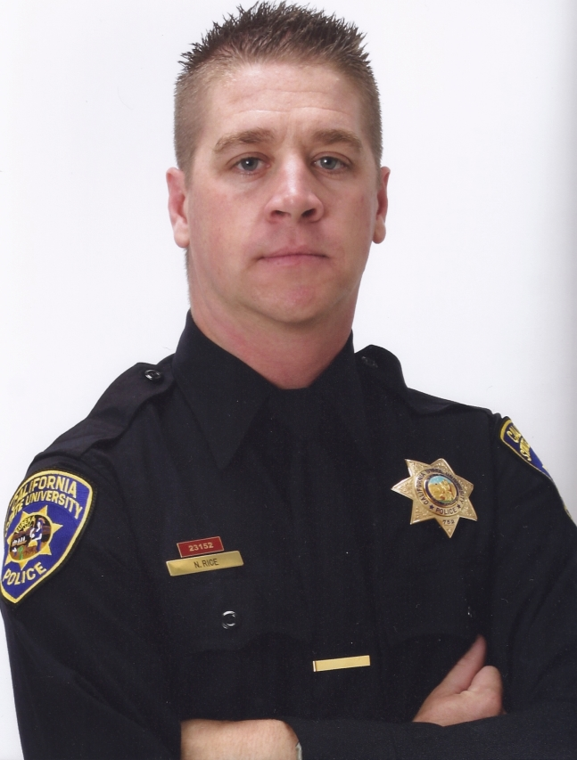
OFFICER/FIREARMS INSTRUCTOR
NATHAN RICE
8 ½ Years working at Sacramento State
B.S. Degree in Criminal Justice from Sacramento State
Favorite Hobby: Firearms Training
MADD DUI Awardee

Slide 12
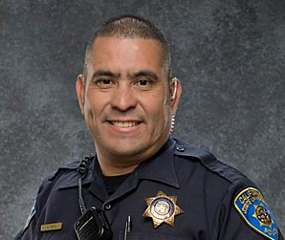
OFFICER
AGUSTIN YAYA
12 years in Law Enforcement
Former Peruvian Police Officer
Favorite Hobbies: Riding motorcycles and playing soccer.
Father of two beautiful girls

Slide 13
SACRAMENTO STATE
POLICE DEPARTMENT
CONTACT US:
(916) 278-6000 or
911 from any campus phone
www.csus.edu/police
www.facebook.com/sacstatepolice

